Slide 1
Data Visualisation with Matplotlib

Slide 2
Matplotlib
Matplotlib is a widely used Python library for creating static, animated and interactive data visualisations.
It can be used directly in Python scripts and in environments such as Jupyter Notebook.
Matplotlib supports many common visualisations, including: line charts, bar charts, histograms, scatter plots, box plots, multiple plots/subplots
The matplotlib.pyplot module provides a convenient interface for creating and modifying plots.
At the beginning, you need to import pyplot and rename is as plt:
  import matplotlib.pyplot as plt

Slide 3
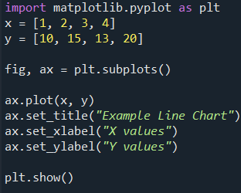
How Matplotlib is organised?
Think of the Figure as the page or canvas, and the Axes as the chart drawn on that page.
fig refers to the Figure
ax refers to the Axes
Matplotlib uses a Figure–Axes structure.
A Figure is the overall canvas that contains the visualisation.
An Axes is the plotting area where data are drawn.
A Figure can contain one or several Axes.
Most plotting and formatting commands are applied to an Axes object.

Slide 4
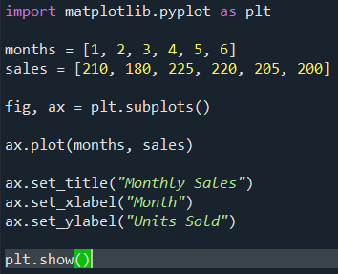
Common Axes Methods
Once you create an Axes object, you use its methods to plot data and customise the visualisation.
Method | Purpose
ax.plot(x, y) | Creates a line chart
ax.scatter(x, y) | Creates a scatter plot
ax.bar(x, height) | Creates a vertical bar chart
ax.barh(y, width) | Creates a horizontal bar chart
ax.hist(data) | Creates a histogram
ax.boxplot(data) | Creates a box plot
ax.plot(): draw the data
ax.set_title(): explain what the chart shows
ax.set_xlabel(): describe the x-axis
ax.set_ylabel(): describe the y-axis

Slide 5




Choosing the Right Chart
Different chart types answer different questions about the data. Choose a chart based on what you want the viewer to understand.
Change or trend over an ordered sequence such as time | Line chart | ax.plot()
Comparison between categories | Bar chart | ax.bar()
Distribution of numerical values | Histogram | ax.hist()
Relationship between two numerical variables | Scatter plot | ax.scatter()
Plot(): Use when the order of the x-values matters, mainly for time series.
Bar(): Use when comparing values across discrete categories.
Hist(): Use to examine the distribution of numerical observations by grouping values into intervals called bins.
scatter(): Use to investigate whether there is a relationship between two numerical variables.

Slide 6
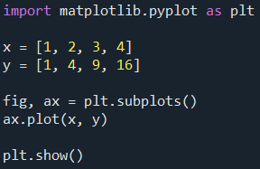
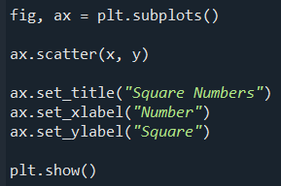
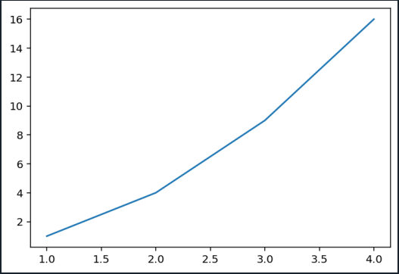
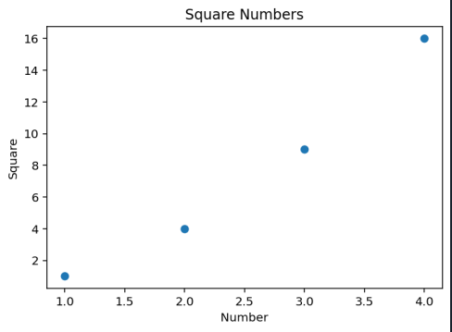
Creating a Simple Plot
Matplotlib can create a chart from a sequence of x- and y-values.
Example 1: A simple line chart
Example 2: Showing the same data as individual points.
ax.plot(x, y) connects the points with a line.
The plotted points are:
(1, 1), (2, 4), (3, 9), (4, 16)
ax.scatter() displays each (x, y) pair as a separate point.
A title and axis labels help the reader understand what the data represent.

Slide 7
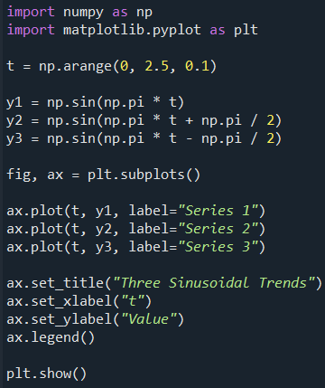
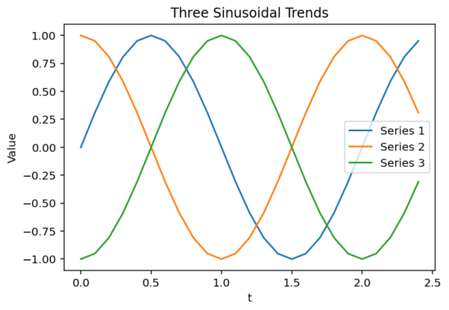
Plotting Multiple Data Series
Matplotlib can display more than one data series on the same Axes.
This is useful when we want to compare patterns or trends directly.
The same x-values, t, are used for all three series.
Each call to ax.plot() adds another line to the same Axes.
label= gives each series a name.
ax.legend() displays those names on the chart.

Slide 8
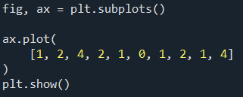
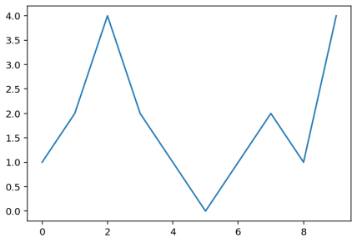
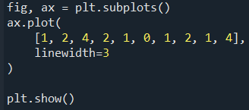
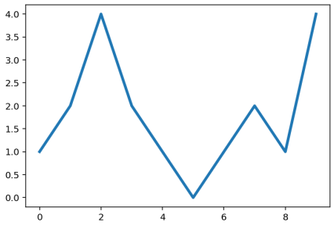
Customising Plots with Keyword Arguments
Matplotlib functions have optional keyword arguments that let us control a plot’s appearance. These are often called kwargs, short for keyword arguments.
We pass these keywords as arguments to functions.
For example, we can change the thickness of a line by setting the linewidth keyword.
In brief: Keyword arguments let us customise a chart without changing the underlying data.
Here, linewidth=3 changes the thickness of the line.

Slide 9
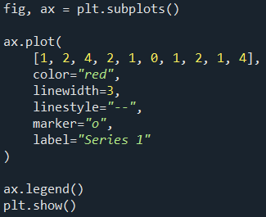
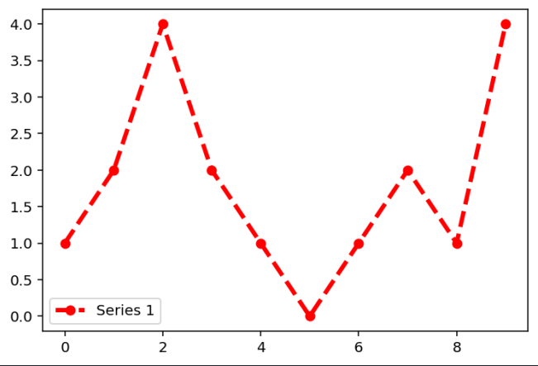
Common keyword arguments
Keyword argument | Purpose | Example
linewidth | Changes line thickness | linewidth=3
linestyle | Changes line style | linestyle="--"
color | Changes line or marker colour | color="red"
marker | Adds a marker at each data point | marker="o"
markersize | Changes marker size | markersize=8
label | Gives the data series a name for the legend | label="Profit"

Slide 10

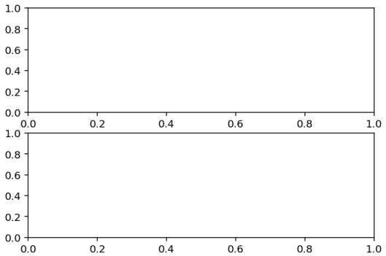
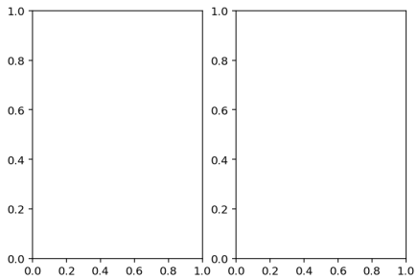
Working with Multiple Axes
2 rows, 1 column
2 Axes arranged vertically
A single Figure can contain several Axes.
Multiple Axes are useful for comparing related visualisations while keeping them separate.
The layout of the Axes is defined by the number of rows and columns.
plt.subplots(rows, columns) creates the required layout.
Creates two Axes arranged side by side.

Slide 11
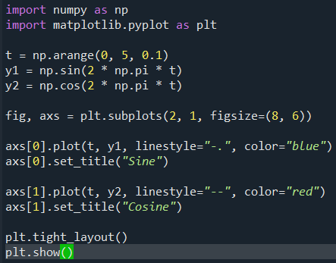
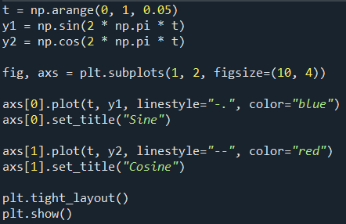
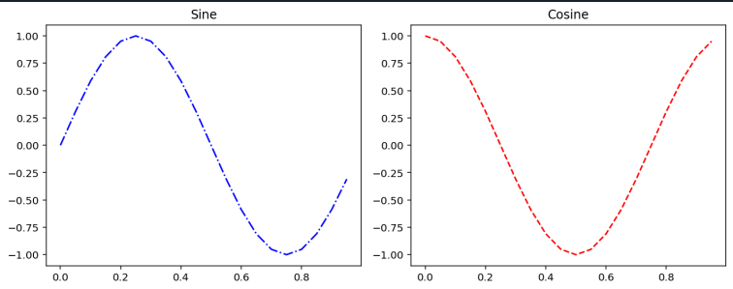
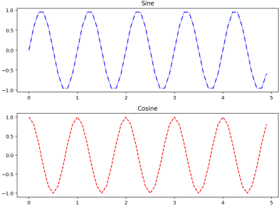
Working with Multiple Figures and Axes
Examples: two sinusoidal trends (sine and cosine)
On the left, 2 rows × 1 column plots stacked vertically.
On the right, 1 row × 2 columns plots arranged side by side
The layout is specified using plt.subplots(rows, columns)

Slide 12
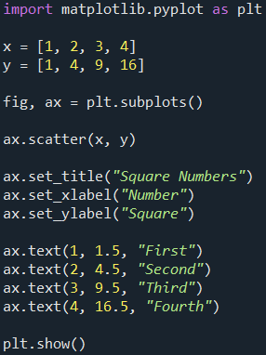
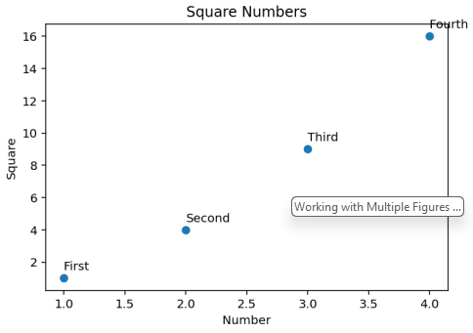
Adding Titles, Labels and Text
The axis labels using label() and a title using title()
Adding text to specific points
The ax.text() method places text at a specified (x, y) position.
The first two arguments specify the position:
ax.text(x_position, y_position, "Text")

Slide 13
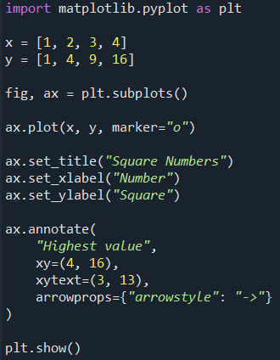
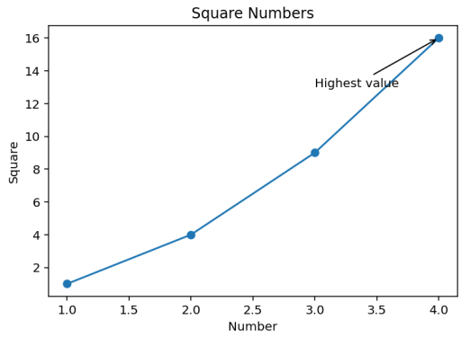
Annotating Important Points
Annotations are useful when we want to draw attention to a specific data point and explain why it is important.
The ax.annotate() method can add both text and an arrow.
xy specifies the data point being highlighted.
xytext specifies where the annotation text should appear.
arrowprops controls the arrow connecting the text to the point.

Slide 14
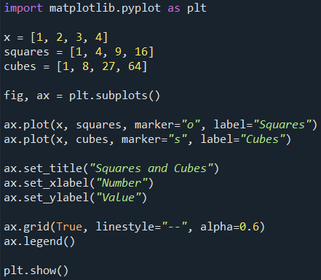
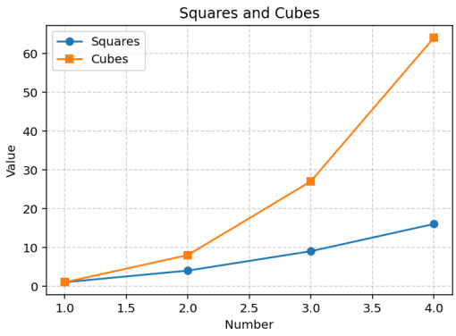
Adding a Grid and a Legend
The ax.grid() function and ax.legend() function
Use a legend when you need to distinguish several data series.
Use gridlines when they help readers estimate values, not just as decoration.
Using label= when plotting each series is clearer and scales much better when there are multiple lines.

Slide 15
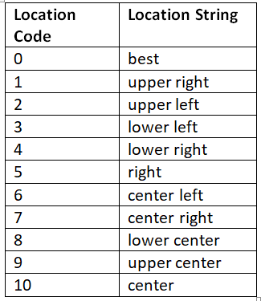
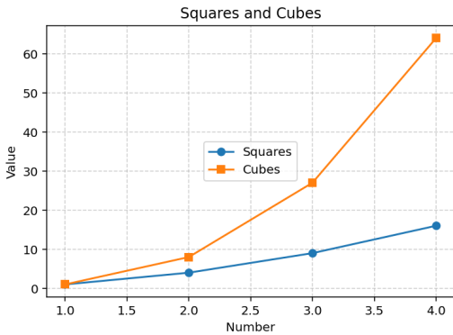
Positioning a Legend
By default, Matplotlib uses loc="best" to choose a suitable position for the legend.
The loc keyword can be used to specify a different position.
loc accepts either descriptive strings or equivalent numeric codes.
Descriptive strings are generally easier to read and understand.
In this example, the loc kwargs was set to 10, which is center

Slide 16
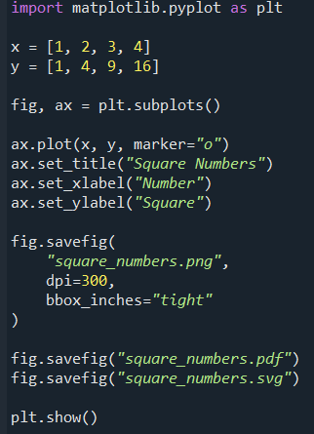
Saving Figures to Files
You can save Matplotlib figures to a file using savefig(). Common formats:
PNG: useful for slides, websites and general use
PDF: useful for documents and scalable output
SVG: vector format suitable for resizing without loss of quality
dpi controls the resolution of raster images such as PNG.
bbox_inches="tight" reduces unnecessary whitespace around the figure.
Saving in another format
Matplotlib uses the filename extension to determine the output format.
Important: Save the figure before closing it.

Slide 17
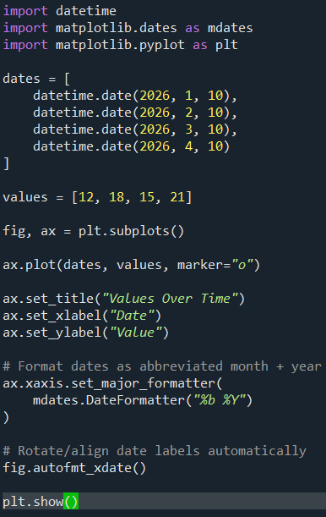
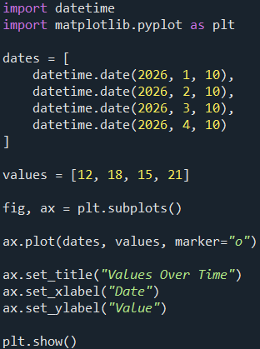
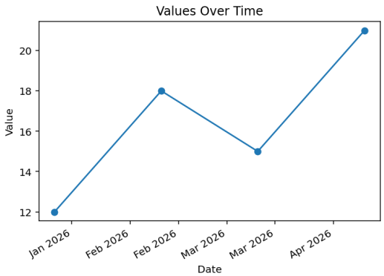
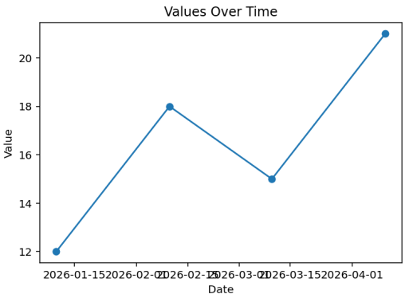
Handling Date Values
Matplotlib can plot Python datetime values directly.
Dates are especially useful on the x-axis when visualising time-series data.
DateFormatter("%b %Y") controls how the dates are displayed
fig.autofmt_xdate() improves the positioning/rotation of the date labels

Slide 18
Useful date-format codes
Code | Meaning | Example
%d | day | 10
%b | abbreviated month | Jan
%B | full month | January
%m | month number | 01
%Y | four-digit year | 2026

Slide 19
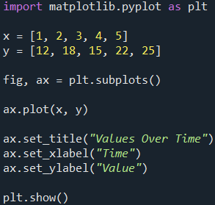
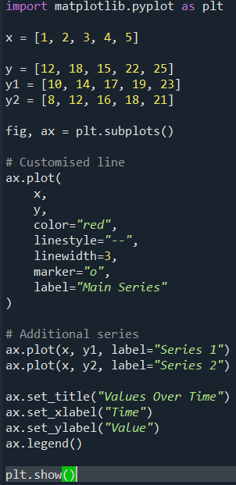
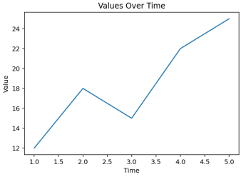
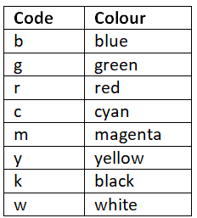
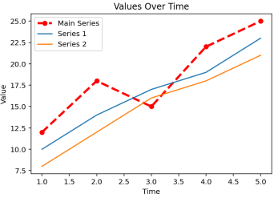
Line Charts
Linear chart is a sequence of data points connected by a line. Useful for: change over time, trends, ordered numerical data, comparisons between several related series.
Each point consists of a pair values(x,y)
You can use the color and linestyle kwargs to define the stroke.
The table below presents the different colour codes

Slide 20
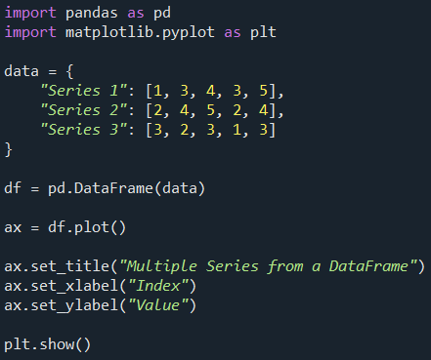
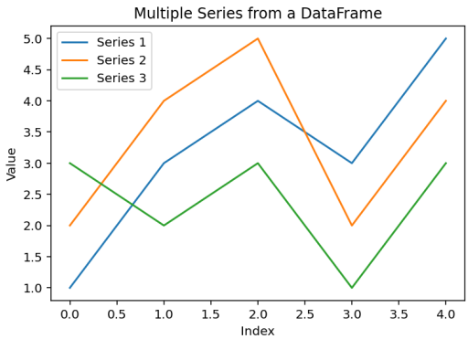
Line charts with a Pandas Dataframe
Pandas DataFrames can be plotted directly using Matplotlib.
Each numeric column can be shown as a separate line.
pd.DataFrame(data) creates the DataFrame.
df.plot() creates a line chart by default.
Pandas automatically uses the column names in the legend.

Slide 21
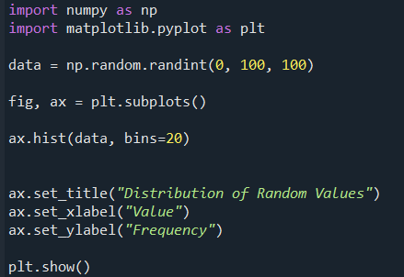
Histograms
A histogram shows the distribution of numerical data by grouping values into intervals called bins.
The x-axis represents ranges of numerical values.
The y-axis shows how many observations fall within each range.
Unlike a bar chart, the bars normally touch because the bins represent adjacent numerical intervals.
The ax.hist()function allows you to represent a histogram.
Practical example: Let’s generate a population of 100 random values from 0 to 100 using random.randint() function as seen below.

Slide 22
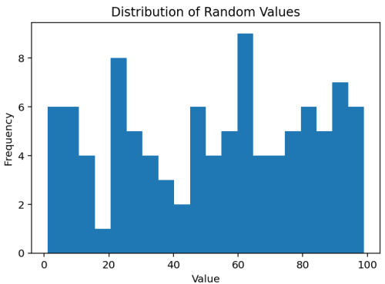
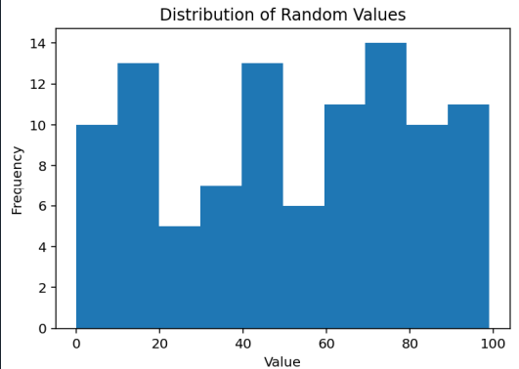
Histograms
Now we will create the histogram of these samples by passing as an argument the ax.hist() function.
We want to divide the occurrences into 20 bins (if not specified, the default value is 10 bins)
To do that, we have to use the kwarg bins.
Default: 10 bins
20 bins
The histogram shows the number of occurrences in each bin

Slide 23
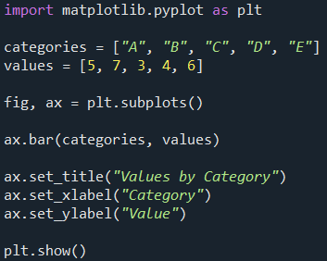
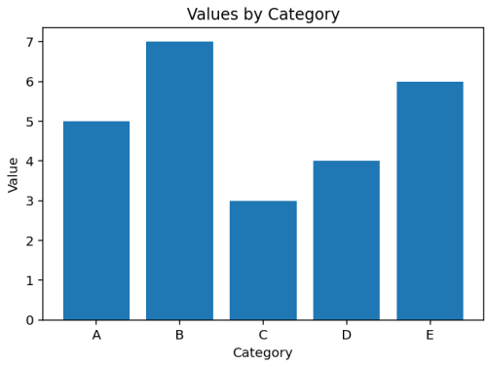
Bar Charts
A bar chart is used to compare values across discrete categories.
The x-axis represents categories.
The height of each bar represents the value for that category.
Unlike a histogram, the bars are normally separated because the categories are distinct.
The ax.bar() function is used to create a bar chart.

Slide 24
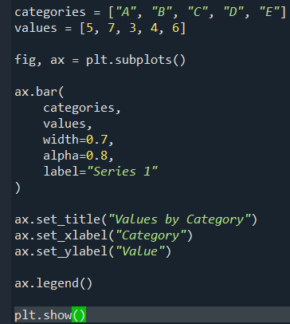
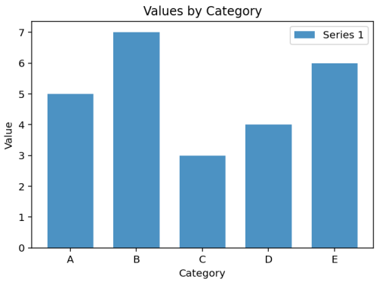
Customising a Bar Chart
Like other Matplotlib plots, bar charts can be customised using keyword arguments.
Argument | Purpose
width | Controls the width of the bars
alpha | Controls transparency (0=fully transparent; 1 = fully opaque)
label | Gives the data series a name
yerr | Adds vertical error bars
capsize | Controls the size of the error-bar caps

Slide 25
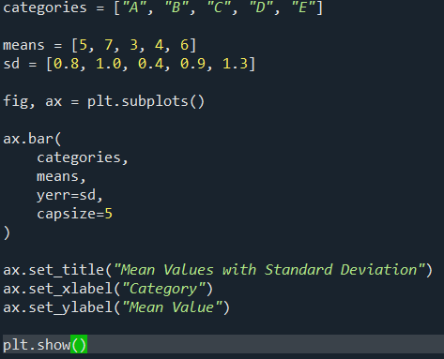

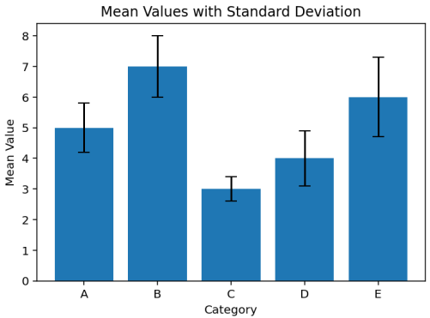
Bar Charts with Error Bars
We can add a specific kwarg as an argument in the ax.bar() function.
The error-bar appearance can be controlled using error_kw, for example:
  ecolor: controls the colour of the error bars
  capsize: controls the size of the caps at the ends of the error bars
The values supplied to yerr might represent:
Standard deviation (SD) — variability in the observed data
Standard error (SE) — uncertainty in the estimated mean
Confidence interval (CI) — a range associated with uncertainty around an estimate

Slide 26
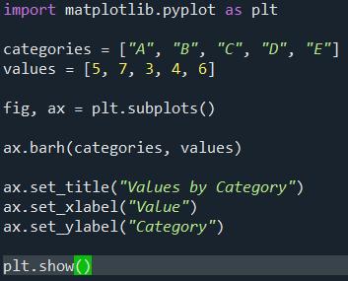



Horizontal Bar Charts
Horizontal bar chart are created using the ax.barh()
Categories are shown on the y-axis.
Numerical values are shown on the x-axis.
ax.bar() uses vertical bars, while ax.barh() uses horizontal bars.
Many of the same customisation options can be used with barh(), but the roles of the x- and y-axes are reversed.
For a horizontal bar chart, use xerr rather than yerr
Horizontal bars are particularly useful when category names are long or when you want to compare many categories clearly.

Slide 27


Multiseries Bar Charts
A multiseries bar chart compares several data series across the same categories.
Each category contains more than one bar.
The bars are placed side by side so the series can be compared directly.
Each series should be clearly identified using a legend.

Slide 28


Multiseries Horizontal Bar Chart
A multiseries horizontal bar chart compares several data series across the same categories using horizontal bars.
Use ax.barh() instead of ax.bar().
Categories are placed on the y-axis.
Numerical values are shown on the x-axis.
Each series is offset slightly so the bars appear side by side.

Slide 29




Multiseries Bar Chart with pandas Dataframe
Pandas can create grouped bar charts directly from a DataFrame.
Use the DataFrame's plot() method.
Set kind="bar" for a vertical grouped bar chart.
Set kind="barh" for a horizontal grouped bar chart.
Each numeric column becomes a separate data series.

Slide 30




Stacked Bar Chart with Pandas Dataframe
A stacked bar chart shows how several data series contribute to the total for each category.
Each bar represents one category.
Each coloured section represents one data series.
The total height or length of the bar represents the combined value.

Slide 31


Diverging bar chart
A diverging bar chart shows values extending in opposite directions from a common baseline, usually zero.
Useful when comparing:
positive and negative values;
increases and decreases;
opposing groups or responses.
Matplotlib provides bar_label()for adding value labels

Slide 32


Pie chart
A pie chart shows how categories contribute to a single whole. Use a pie chart only when:
the categories represent parts of the same total;
the values are non-negative;
there are only a small number of categories;
comparing approximate proportions is more important than comparing precise values.
ax.pie() converts the supplied values into proportions of their total.
Use the explode kwarg to highlight a slice. E.g. B
User the startangle to adjust the rotation of the pie. It takes an integer value between 0 and 360, which is the degree of rotation. (0 is the default)
autopct can be used to display those proportions as percentages.
Use the shadow kwarg to add a shadow to an image by setting it to True.

Slide 33


Pie Charts with a Pandas Series
The pie chart can only represent one data series at a time.
If the data are stored in a DataFrame, select the column that you want to visualise.
In this example, we select one Pandas Series containing the values to be plotted.
The kind kwarg is used to specify the type of chart.
autopct=“%1.1f%%“ displays percentages on the slices.

Slide 34






Scatter Plot
Scatter() A scatter plot shows the relationship between two numerical variables.
Each point represents one observation with an (x, y) pair.
Scatter plots are useful for identifying: positive or negative relationships; clusters; gaps; unusual observations or outliers.
rng.integers() generates random integer values.
Group 1 is generated from a lower x-value range.
Group 2 is generated from a higher x-value range.
Scatter plots can encode extra information using marker size and colour.

Slide 35


Box Plots
A box plot summarises the distribution of numerical data.
It can help us compare: the median, the spread of the middle 50% of values possible outliers, and differences between groups
The line inside the box shows the median.
The box covers the interquartile range (IQR), from Q1 to Q3.
The whiskers extend to values within the usual whisker rule.
Points beyond the whiskers may be shown as potential outliers.

Slide 36


Box Plots with a Pandas DataFrame
Pandas can create box plots directly from data stored in a DataFrame.
This is particularly useful when we want to compare the distribution of a numerical variable across several categories.
Why use plt.suptitle("")?
DataFrame.boxplot(by=...) automatically adds an additional overall title.
plt.suptitle("") removes it.

Slide 37


Inset Axes
An inset Axes is a smaller plotting area placed inside a main Axes. It can be useful for:
showing a zoomed-in region;
displaying a related secondary view;
highlighting a subset of the data.
To create one, first create the main Figure and Axes, then use ax.inset_axes() to add a smaller Axes inside the main Axes.

